Slide 1

Caffeine
Study
04.28.26
Blake Dee

Slide 2
Defining the Problem
Caffeine Study
Research Question:
Does my caffeine intake differ between school days and days that I work during the week?

Slide 3
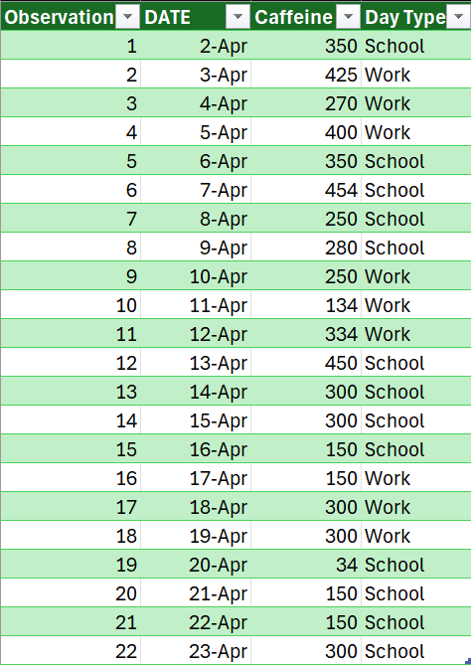
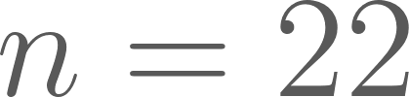
Data Set
Data
Caffeine Study
22 Observations ( )
Variables:
Type of day
work or school
Amount of caffeine consumed (mg)
Used this spreadsheet to track

Slide 4
Summary Statistics
Summary Statistics
Caffeine Study
Summary: | School Days (mg) | Work Days (mg)
Minimum | 34 | 134
1st Quartile | 150 | 200
Mean | 270.62 | 284.78
Median | 300 | 300
3rd Quartile | 350 | 367
Maximum | 454 | 425
Standard Deviation | 118.04 | 93.19

Slide 5
Forming a Hypothesis
Caffeine Study
Hypothesis
Claim: There is no difference in average daily caffeine intake between school days and work days.
Variables:
Dependent: Caffeine Consumed (mg)
Independent: Type of day (school or work)

Slide 6
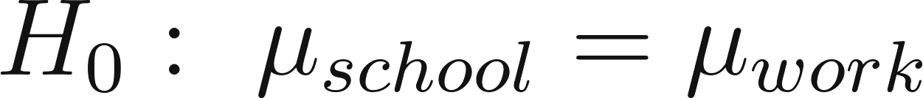
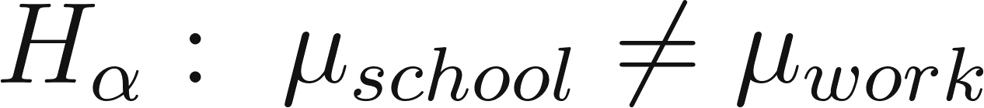
Hypothesis Testing:
Hypothesis Testing
Caffeine Study
Null Hypothesis:
Alternative Hypothesis:
Testing:
2 sample t-test

Slide 7
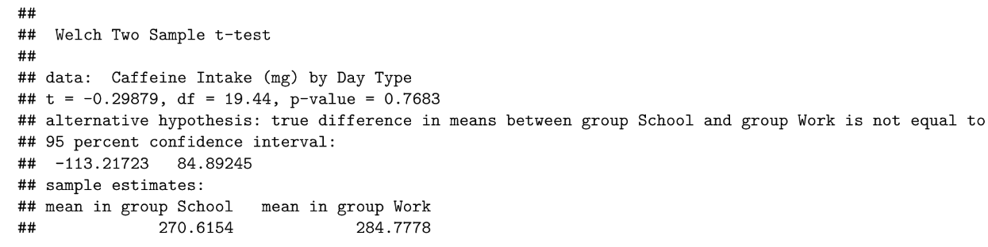
Hypothesis Testing:
Hypothesis Testing
Caffeine Study
Test Statistic
T= -0.29879
P-value: 0.7683
Using a significance level of 0,05, we fail to reject the null hypothesis,

Slide 8
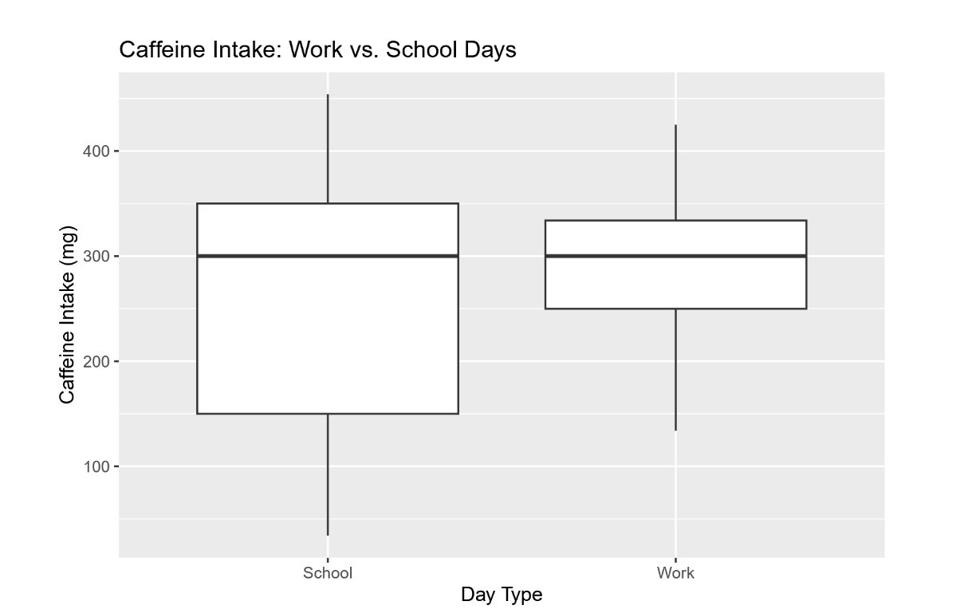
Drawing a Conclusion
Drawing a Conclusion
Caffeine Study
Since the p-value, 0.7683, is greater than 0.05, we fail to reject the null hypothesis.
There is not enough evidence to support the claim that the mean caffeine intake on school days is different to that of work days.

Slide 9
Limitations:
Limitations
Caffeine Study
Small data set
An outlier (34mg) affecting results
Only reflects my habits, not a population’s
Self-reported
Other variables might have contributed to an increase or decrease in caffeine intake (i.e. sleep quality, stress, etc.)
Potential inaccuracies for caffeine count during a day

Slide 10
Github
Github Link
Caffeine Study
https://github.com/Blake-Dee/DATA

